Slide 1

Data Synthesis For Object Recognition
Xi Zhang
Advisor: Professor Agam
xzhang22@hawk.iit.edu
Computer Science Department
Illinois Institute of Technology
Notes:
10/29/17
1
1

Slide 2
Overview
Motivation.
Introduction and novel contributions.
Data synthesis in data space.
Features to learn from synthetic data
Eliminating synthetic gap.
Data synthesis in feature space.
Conclusion
Notes:
10/29/17
2
2

Slide 3
Motivations and Importance of the problem.
Introduction and novel contributions.
Data synthesis in data space.
Features to learn from synthetic data
Eliminating synthetic gap.
Data synthesis in feature space.
Conclusion.
Notes:
10/29/17
3
3

Slide 4
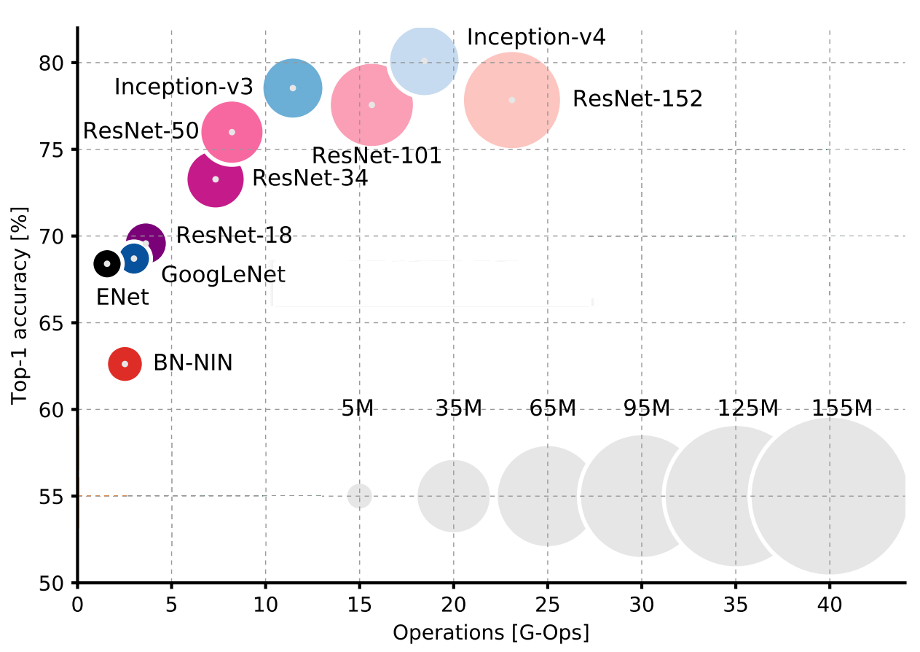
Motivation
Model complexity V.S. Accuracy On ImageNet dataset
Fig cited from: A. Canziani etc. An analysis of deep neural
network models for prectical applications, 2017
Notes:
10/29/17
4
4
The more complicated model is, the better results will be.
More complicate model, more data disired.

Slide 5
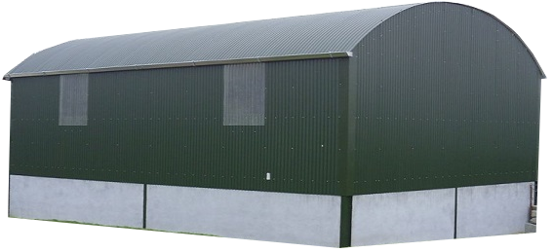
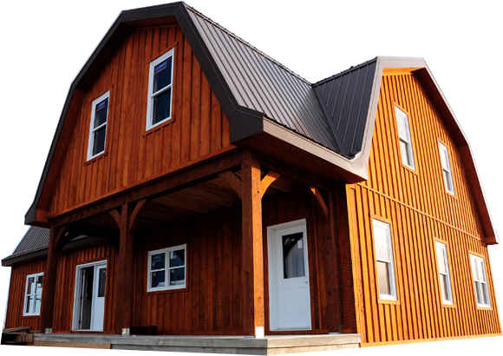
To gain a good performance of a machine learning process, more high quality data is always desired.
Rare cases (absolute rarity)
Rare classes (relative rarity)
Chicago
1%
1%
21%
FLAT
SHED
HIP
Curved
2%
39%
HEX
GABLE
1 0%
PYRAMID
UNKNOWN
2%
MANSARD
CURVED
23%
1%
Mansard
Notes:
10/29/17
5
5
****Rare cases:
--in an absolute sense.
--Difficult to detect regularities with in rare data.
--Researches in the past shown that rare cases have a much higher misclassification rate than common cases.
****Rare classes:
--objects are rare relative to other objects. Like a needle in a haystack.
--mining this kind of data is hard is because, rare objects are not easily located using greedy search heuristics and more global methods are, in general, not tractable.
****Problems of rarity learning:
--Improper evaluation metrics.
Metrics are used to guide the data mining algorithm and to evaluate the results of data mining. If the metric does not take care of rarity, then data mining is not likely to handle rare classes very well.
--Inappropriate inductive bias
Bias is crucial to data mining performance. Many learners utilize a general bias to avoid over-fitting, however, this bias can adversely impact the ability to learn rare cases.
–Noise
Noise has a greater impact on rare cases than on common cases. Because for common cases, learner has a better ability to generalize when having noise.

Slide 6
2) Supervised learning requires high quality labeled data.
Time consuming, expensive.
Sometimes, impossible
Notes:
10/29/17
6
6
Ask help from crowd sourcing such as Amazon mturk, specific tool has to be created. but attendant is not professional, noisy labeling.

Slide 7
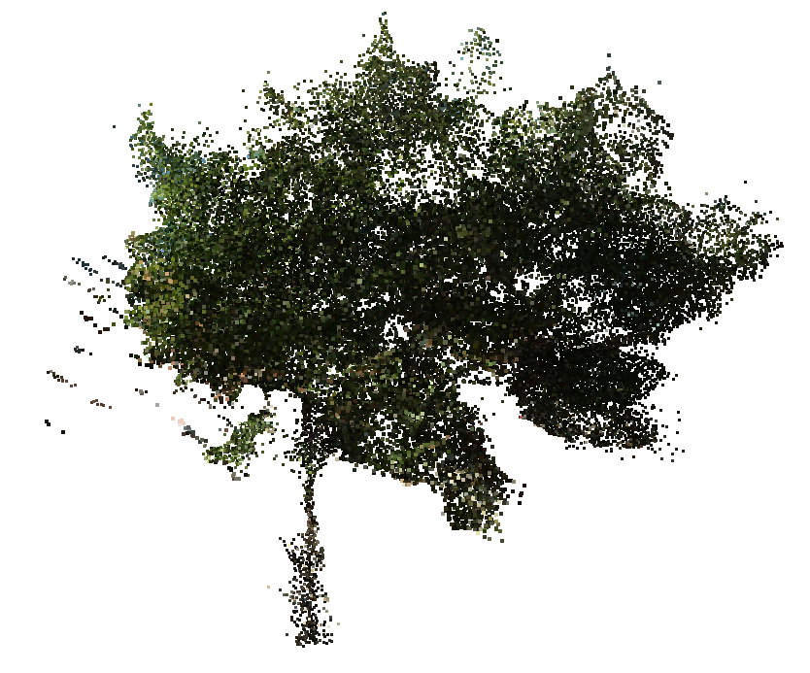
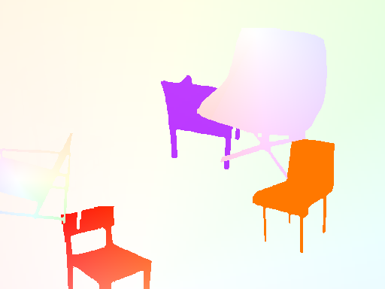
2) Supervised learning requires high quality labeled data.
Time consuming, expensive.
Sometimes, impossible
2D optical flow
3D point cloud
Notes:
10/29/17
7
7
Example 1: Learning based estimation of optical flow, learner need pixel-wise labeling of flows
Example 2: Recognition objects from point cloud. Need point-wise labeling.

Slide 8
Motivations and Importance of the problem.
Introduction and novel contributions.
Data synthesis in data space.
Learning from synthetic data.
Eliminating synthetic gap.
Data synthesis in feature space.
Conclusion.
Notes:
10/29/17
8
8
****Instead of solving these mentioned problems and challenges from point of view of learning algorithm itself, we focus on data synthesis. Simply put, I create synthetic data, on one hand, to ease data labeling work in a supervised learning algorithm, on the other hand, to boosting performance of a learning algorithm.
****The topic is very challenging and there are many problems we need to solve. For example, how synthetic data should be generated, how to learning the synthetic data, so the learner later on can be used to recognize actual data.

Slide 9
Solution:
Synthesizing data which will be used as training data.
Challenges:
Where to synthesize? (As image or as features)
How to synthesize?
How to use synthesized data?
Notes:
10/29/17
9
9
****Instead of solving these mentioned problems and challenges from point of view of learning algorithm itself, we focus on data synthesis. Simply put, I create synthetic data, on one hand, to ease data labeling work in a supervised learning algorithm, on the other hand, to boosting performance of a learning algorithm.
****The topic is very challenging and there are many problems we need to solve. For example, how synthetic data should be generated, how to learning the synthetic data, so the learner later on can be used to recognize actual data.
Where to synthesize: Directly synthesizing images, 3D objects or just synthesizing feature representation of data.
How to synthesize: Different data has different representation, it is challenge to come up an uniform approach taking care of every corner case. On the one hand, the data should be real enough to mimic existing actual data. One the other hand, the method should generalize very well that it can produce unseen data as well.
How to use: In some approach, the synthesized model only capture essential element of existing data and ignore minor details. How to deal with such difference between two data is a question.

Slide 10
Novel contributions:
Data synthesis in data space.
Features to learn from synthetic data
Eliminating synthetic gap.
Data synthesis in feature space.
Notes:
10/29/17
10
10
****Instead of solving these mentioned problems and challenges from point of view of learning algorithm itself, we focus on data synthesis. Simply put, I create synthetic data, on one hand, to ease data labeling work in a supervised learning algorithm, on the other hand, to boosting performance of a learning algorithm.
****The topic is very challenging and there are many problems we need to solve. For example, how synthetic data should be generated, how to learning the synthetic data, so the learner later on can be used to recognize actual data.

Slide 11
Motivations and Importance of the problem.
Introduction and novel contributions.
Data synthesis in data space.
Features to learn from synthetic data
Eliminating synthetic gap.
Data synthesis in feature space.
Conclusion.
Notes:
10/29/17
11
11

Slide 12
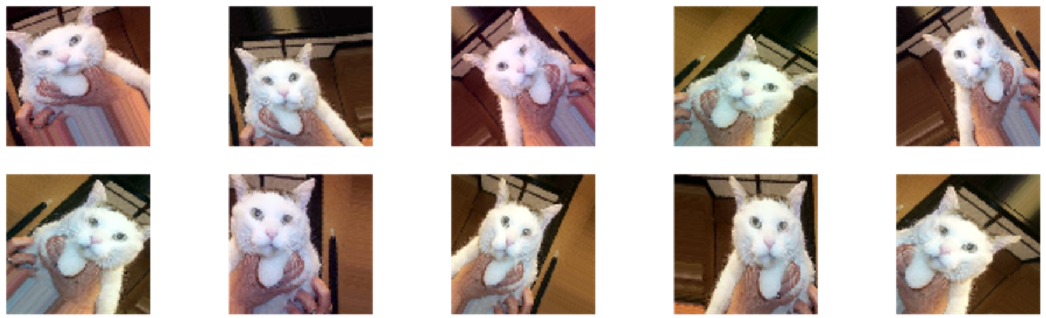
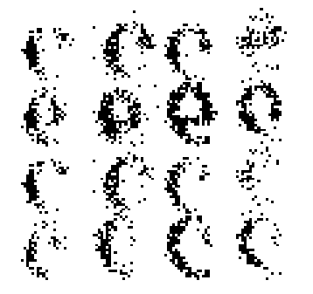
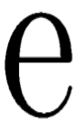
Existing methods.
Geometric transformation. [138][139]
Color space transformation. [6][113]
Notes:
10/29/17
12
12
Geometric trans: Transform images in different ways: translate, rotate, stretch etc.
Color trans: adding color noise, change contrast, saturation, etc.

Slide 13
Disadvantage of existing methods.
Notes:
10/29/17
13
13
Existing approaches only create samples that are close to the original sample, which limit the range the underlying method can learn.

Slide 14
The Proposed Approach
In contrast to existing methods, two approaches are used in my research:
Generate data.
Generation based on specified templates.
Generation based on learned templates.
Combination of specified and learned templates.
Generate labels.
Generating labels based on unsupervised learning.
Notes:
10/29/17
14
14
Add labels based on supervised learning is useless. Thus, add labels based on unsupervised learning.

Slide 15
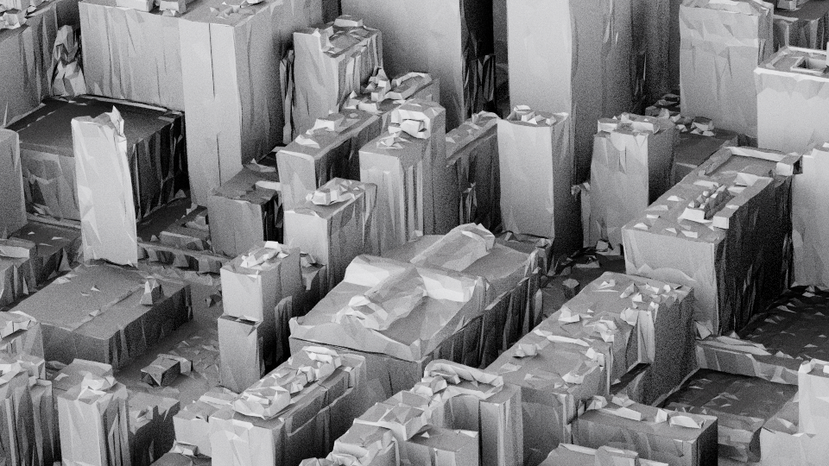
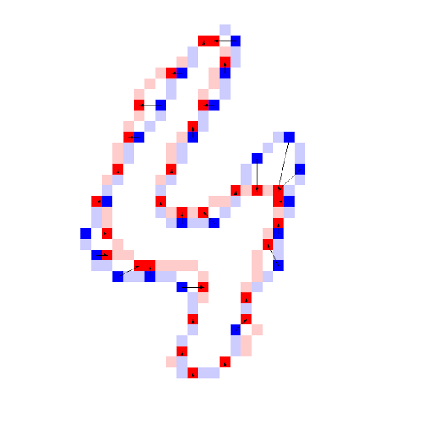
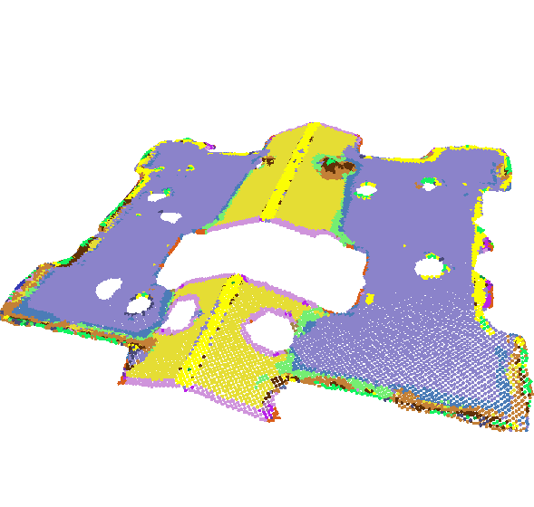
Generate data
Aerial LiDAR roof style
classification [20]
Handwritten digits
recognition [25]
Point cloud roof points
classification [20]
Notes:
10/29/17
15
15
I will give three examples to show how data can be generated.

Slide 16
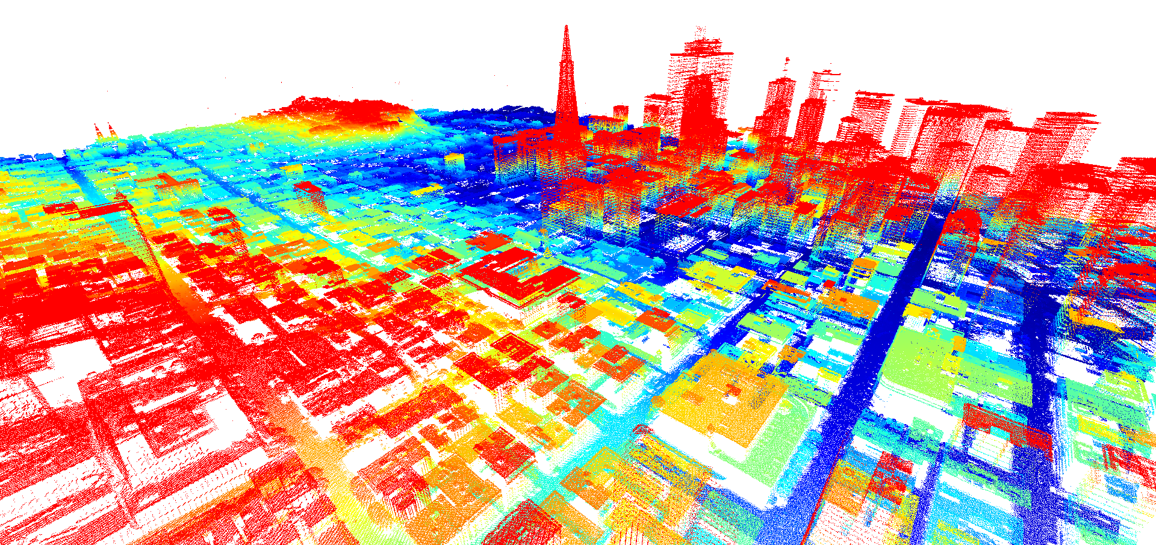
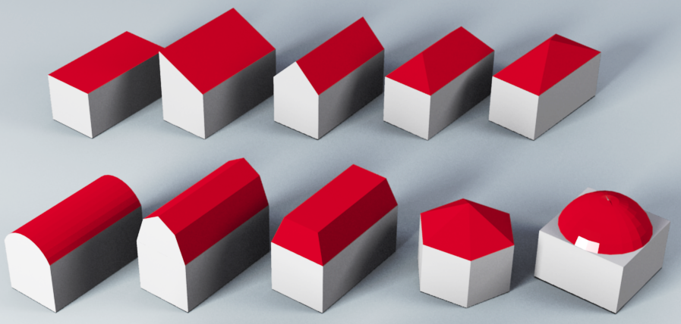
Generation based on specified templates
Aerial LiDAR
Downtown San Francisco
Candidate roof styles
Notes:
10/29/17
16
16
The dataset is a point cloud dataset. Every building roof contains more than at least 5k points. Some large roofs can have 30k points. Existing method tried to detect geometrical features such ridge, concave and corners of roofs. And classify roofs based on these simple geometry features.

Slide 17
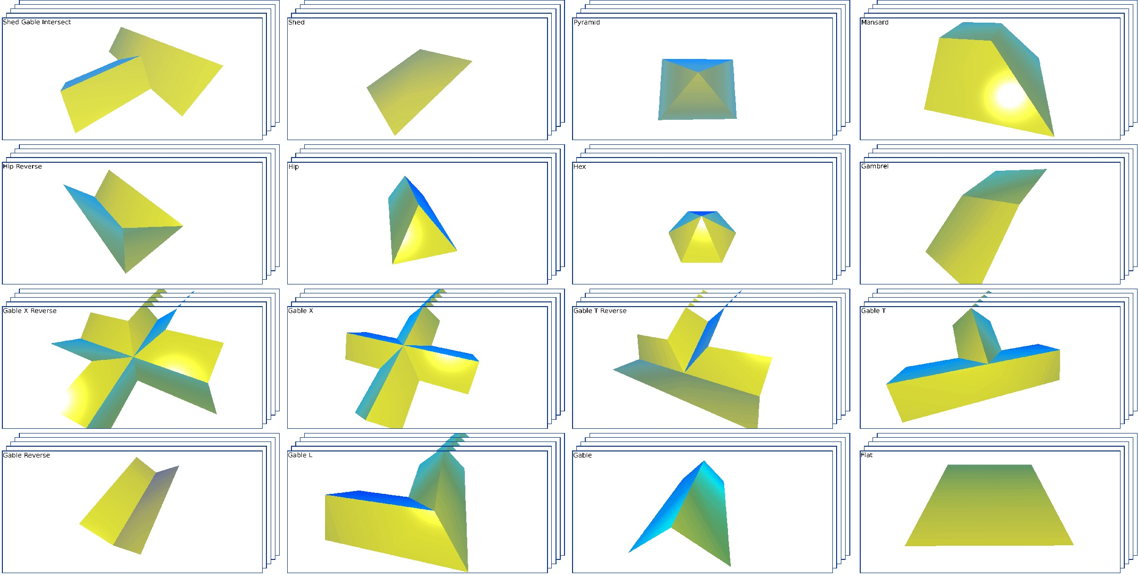
Build prototypes.
Notes:
10/29/17
17
17
Similar to bag of words representation in natural language processing, I used bag of words model in this project to represent point cloud building roofs.

Slide 18
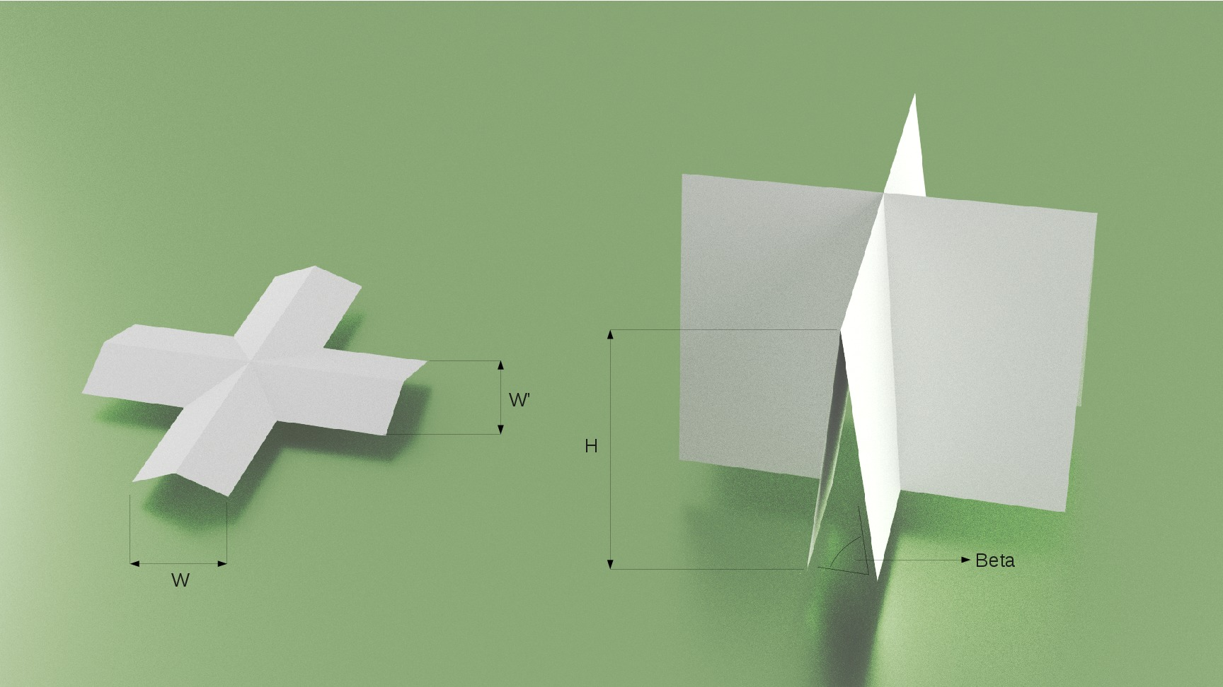
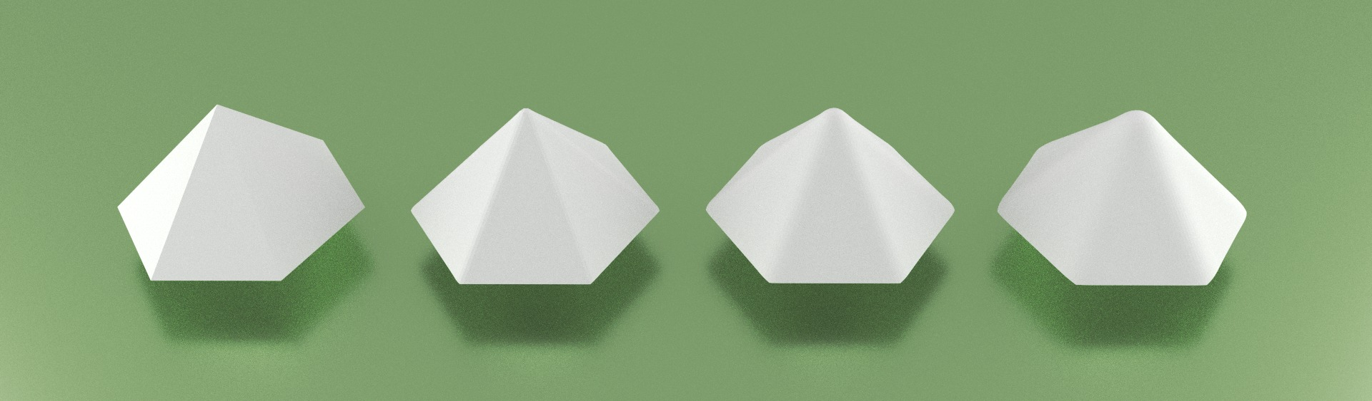
Derive more data.
Dimension change
Simulation of erosion
Notes:
10/29/17
18
18
I make width, height of templates adjustable. To simulate round corner or ridges, I even add 4 levels of erosions. The goal is to cover as much cases in real works as possible.
In next section, I will show how features are extracted from these models and trained using a machine learning algorithm.

Slide 19
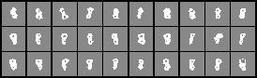
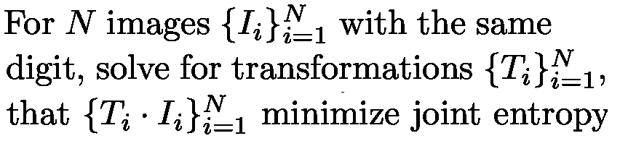

Generation based on learned templates
Generate prototype by unifying images.
which is a measure of uncertainty of a set of variables.
Notes:
10/29/17
19
19
Given a lot of digit images. Each of them is assigned a transformation matrix. The goal here is to transform each image independently so that at the end when all of these images overlapping together, the joint entropy is minimized.
Geometrically transform images to minimize joint entropy, means sum of joint entropies of all possible pairs of images.

Slide 20

Building correspondence among data.
Set control points on prototype.
Find corresponding control points on each data.
Notes:
10/29/17
20
20

Slide 21
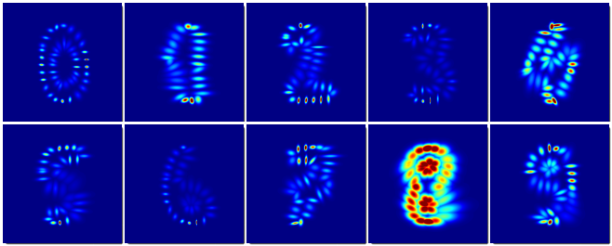
Data synthesis by drawing samples from a computed distribution.
Data synthesis by interpolation/extrapolation between nearest neighbors.
Notes:
10/29/17
21
21
Model distribution of control points’ location as multi variant gaussian.

Slide 22
Boost the performance by adding synthetic data.
 | Real | Syn | Real+Syn
CNN | 0.65 | 0.68 | 0.70
SVM | 0.77 | 0.78 | 0.80
Samples # | 2000 | 20000 | 2000+20000
F1 score of classification results
Notes:
10/29/17
22
22

Slide 23
Combination of specified and learned templates.
Roof type classification from point cloud

Slide 24
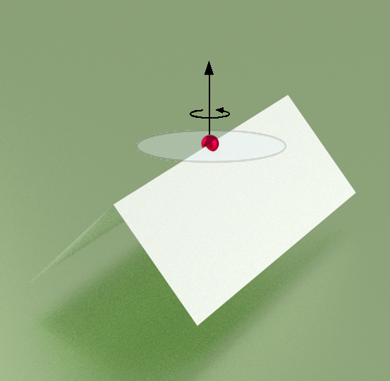
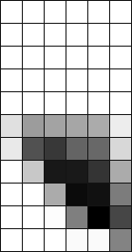
Extract features that characterize local geometry.
Spin image
Notes:
10/29/17
24
24
For all neighbor points of this red points, I map the locations of these points to this 2D map. 2D map then works as a 2D histogram. At the end of this process, it turn out that, the spin image could describe the local geometry around this red point very well.

Slide 25
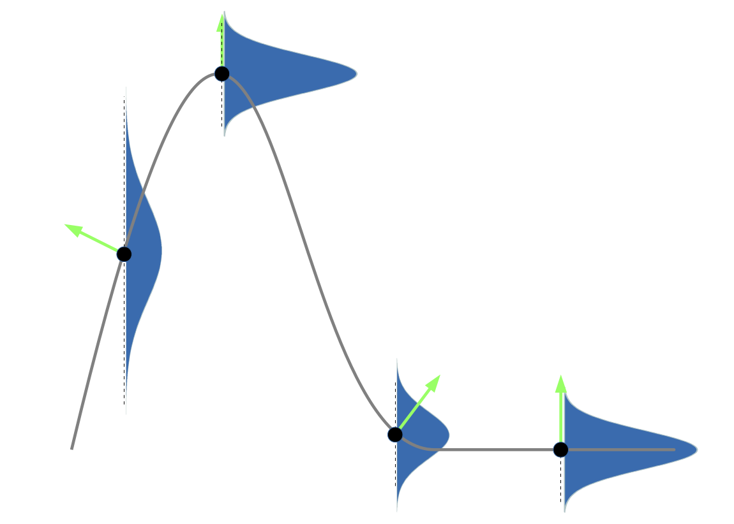
Learning bumpiness as a function of surface slope.
Notes:
10/29/17
25
25
Actual roofs are bumpy, noisy and have holes. Such features are subtle to treat one by one
I summarized all of these cases as bumpiness of roof surface.
I learned bumpiness as a function of surface slope, the shape is very much like a exponential function. The function curve then is discretized to several intervals, inside each intervals, I fit a gaussian model for bumpiness.

Slide 26
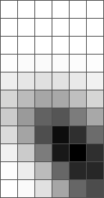
Add random noise to synthetic data using knowledge learned.
Spin image
Notes:
10/29/17
26
26

Slide 27
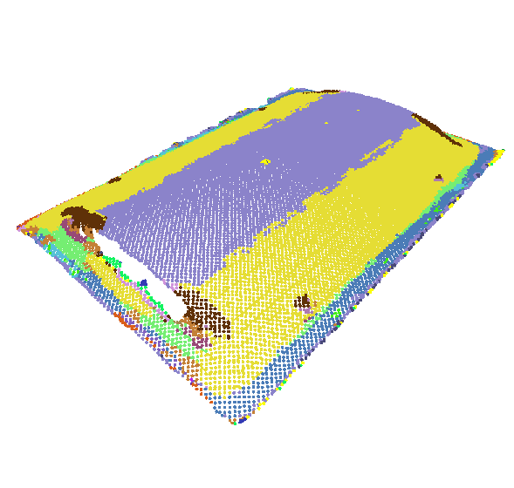
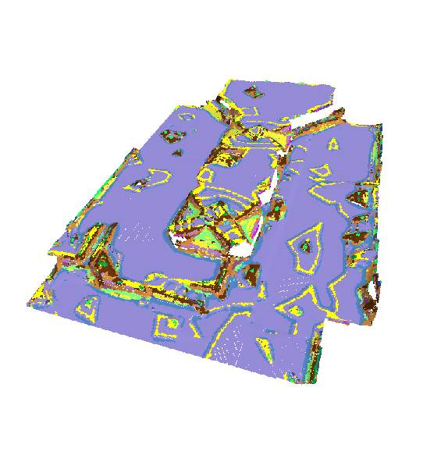
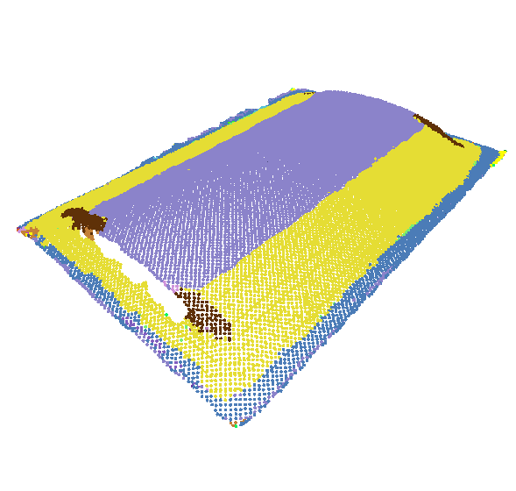
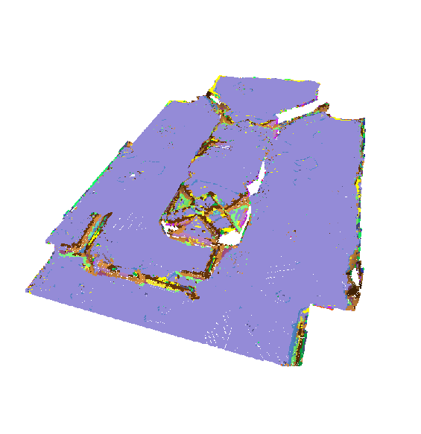
Point semantics classification results.
Without feature refinement
With feature refinement
Notes:
10/29/17
27
27

Slide 28
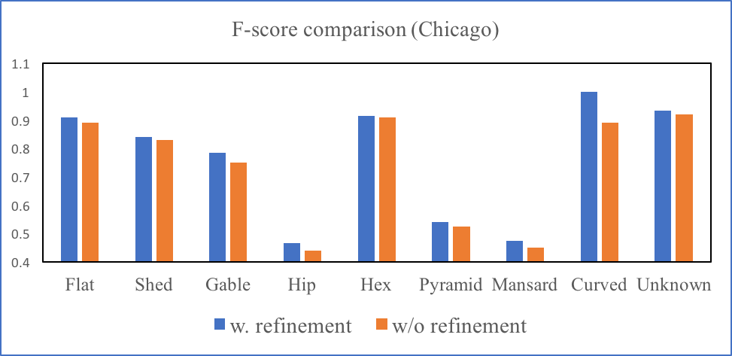
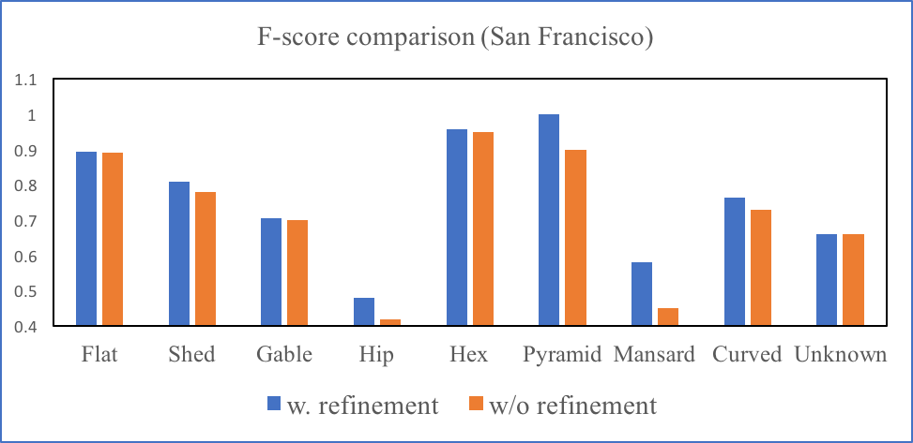
Recognition rate by adding refinement to point features.
Notes:
10/29/17
28
28
To show advantage of using models derived by these carefully designed models as training data. I compared results to unsupervised clustering algorithm, GMM and Kmeans.
For roofs that are rare in real world, my approach over perform compared method a lot. That’s because more features can be generated and trained using the proposed method.

Slide 29
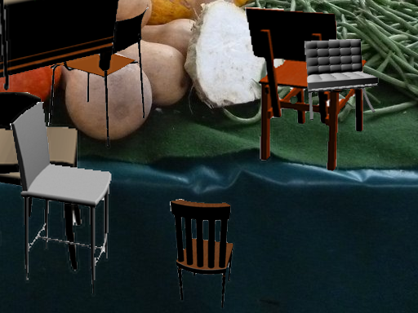
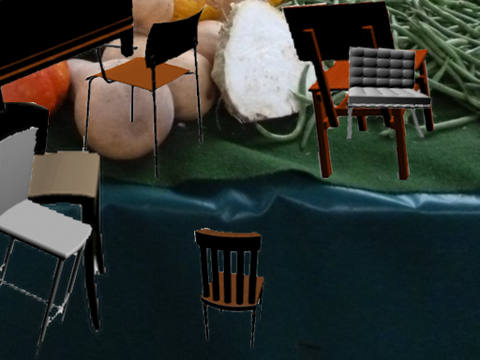
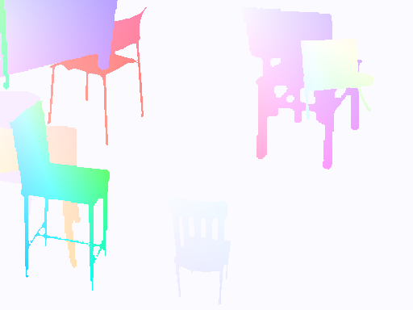
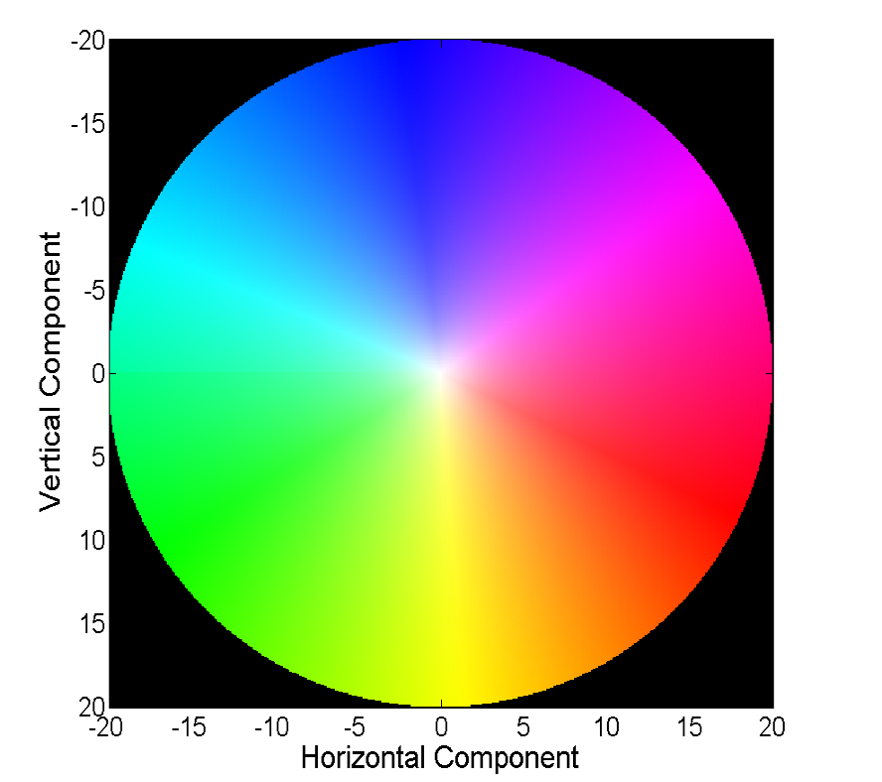
Generating labels based on unsupervised learning
Unsupervised learning of optical flow using neural networks. [23]
Notes:
10/29/17
29
29
Each optical flow is rendered using colors in color space. Similar color means similar flow vector.

Slide 30
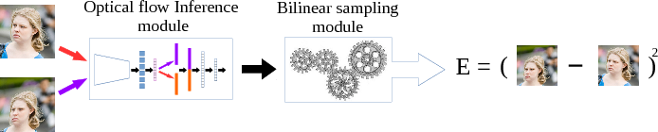
Framework of unsupervised optical flow learning
Notes:
10/29/17
30
30
Goal is to use unsupervised learned label to improve supervised learning.

Slide 31
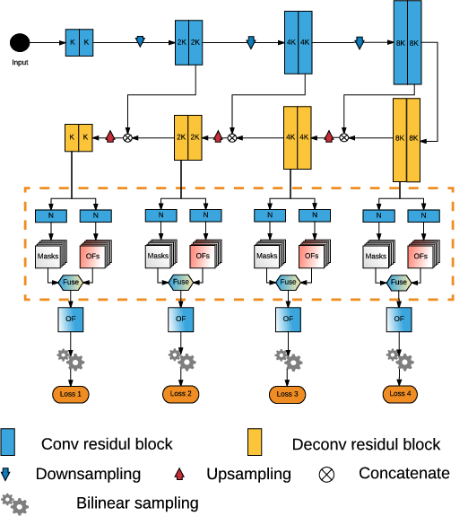
Introduction of using mask modules
Notes:
10/29/17
31
31
The idea of using mask is to separate one image of optical flow to multiple layers. There is no intersection between any layers and the union of all layers is the final optical flow.
The idea comes from a fact that multiple different motion could being found in one pair of sample images, I find out that by estimation these motion using different layers generating more accurate results than existing method. The assumption is that in each separated layer, the optical flow in that layer is sort of consistant which represents one type of motion in the images.

Slide 32
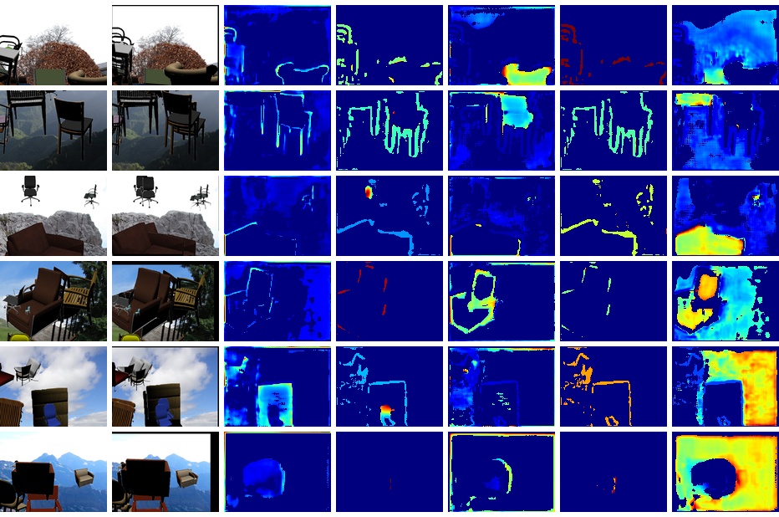
Learned masks.
Notes:
10/29/17
32
32
The optical flows are separated to 5 different layers. The value of mask is rendered using color, dark blue represents 0 value.

Slide 33
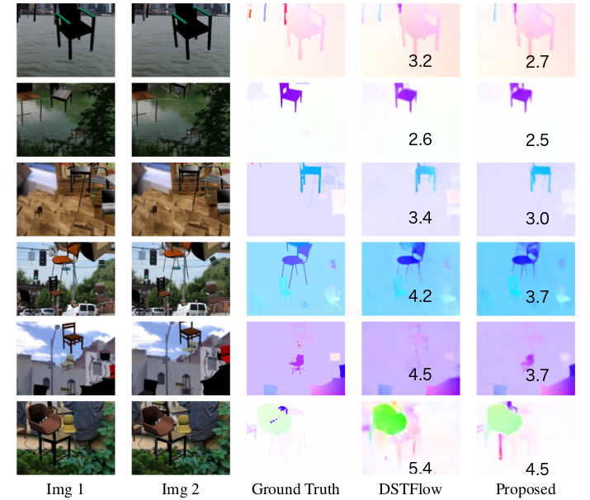
Results
[77]
Notes:
10/29/17
33
33
The proposed method generate results that have much more clear optical flow at objects boundaries and also better for small objects.

Slide 34
Results
Training set | Test set | FlowNet
KITTI labeled data (200) | KITTI labeled test set (200) | 5.23
KITTI labeled data (200) + Chairs labeled data (20k) | KITTI labeled test set (200) | 4.43
KITTI w. pred’ labels (40k) + Chairs labeled data (20k) | KITTI labeled test set (200) | 2.31
KITTI w. pred’ labels (40k) + KITTI labeled data ( 200) + Chairs labeled data (20k) | KITTI labeled test set (200) | 2.21
Notes:
10/29/17
34
34
To further demonstrate the value of predicted optical flows using the proposed method, I show how these predicted optical flows can be used as training data to generate better results.
Chairs is another dataset people used to used as combined training set in experiments. Chairs have more than 20K data with ground truth optical flows.

Slide 35
Motivations and Importance of the problem.
Introduction and novel contributions.
Data synthesis in data space.
Features to learn from synthetic data
Eliminating synthetic gap.
Data synthesis in feature space.
Conclusion.
Notes:
10/29/17
35
35

Slide 36
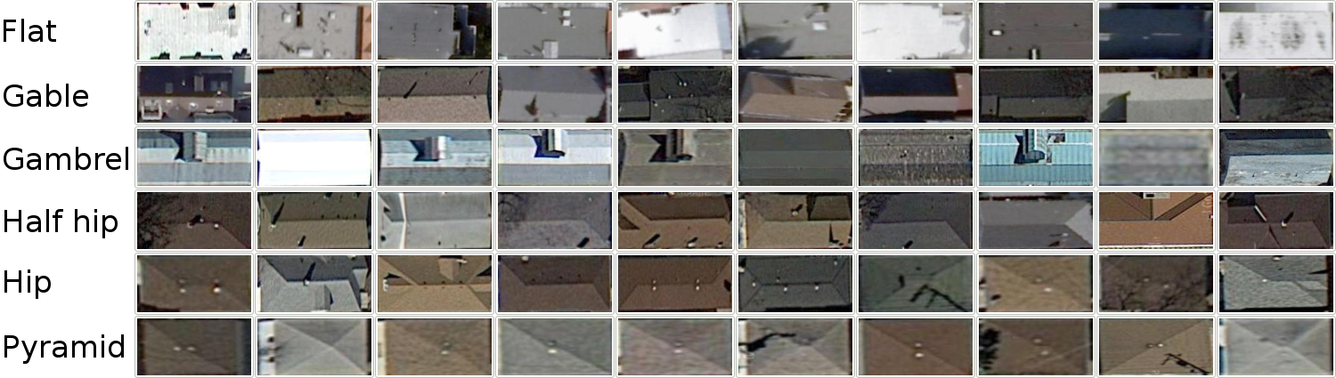
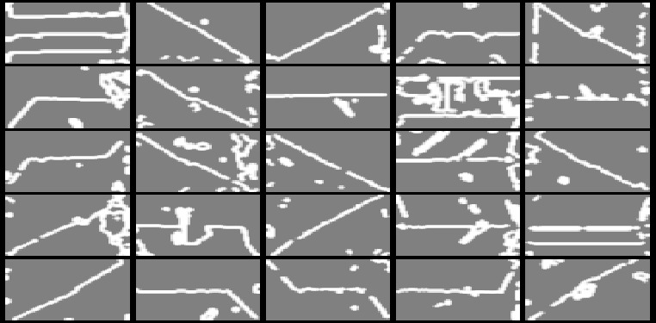
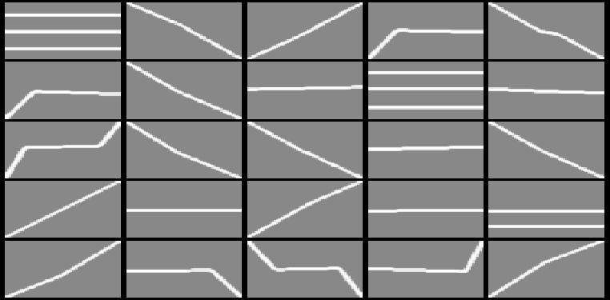
A Challenging task.
Actual data
Synthetic data
Notes:
10/29/17
36
36
Synthetic data created as images or 3D models, may look a lot different than actual data.
When extracting features from synthetic data, make machine learning algorithm very hard to learn from them and predict on actual data.
As shown in this example, when we extract features that describe the geometry of these lines, features of actual data looks very different from real data.

Slide 37
Previous work.
They all treat synthetic data as actual ones.[68][136][114][138][139]
Notes:
10/29/17
37
37

Slide 38
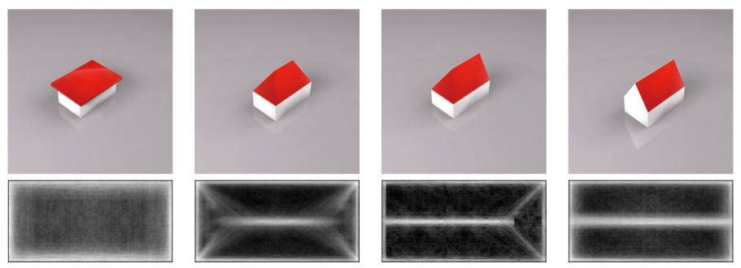
The proposed approach.
Design features that would be insensitive to differences between synthesized and actual data
Roof type classification from satellite images [21]
Notes:
10/29/17
38
38
Type I: ignore features that represent minor features of actual data.
Type II: Make synthetic feature close to actual features.

Slide 39
Satellite image roof style classification.
Actual data
Synthetic data
Features expected:
Ignore small blobs in actual data.
Highlight the most evident structure of roofs.
Notes:
10/29/17
39
39
Ignore small blobs in actual data: some blobs may be just noise, they play no role in deciding types of roofs.
Highlight the most evident structure of roofs: which are these edges.

Slide 40
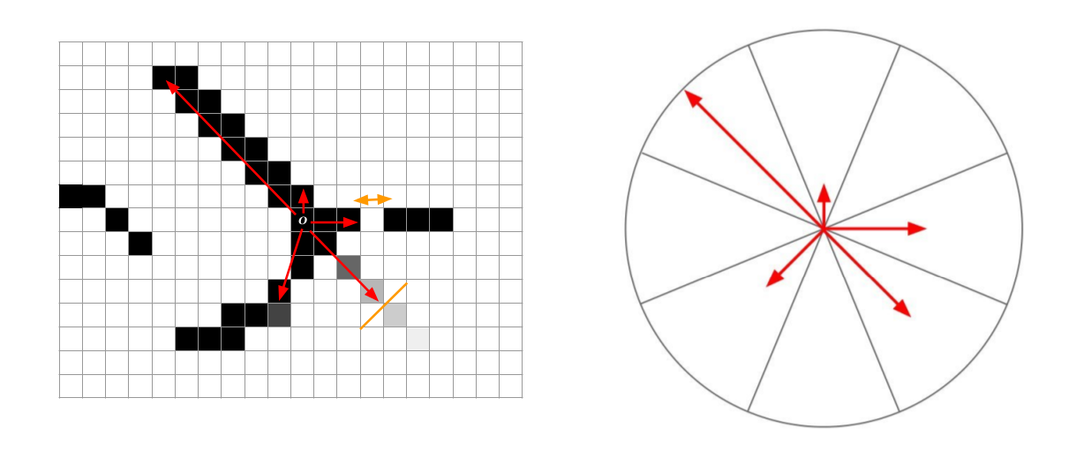
We proposed a feature called Histogram of Ray (HOR) in [21] to highlight edge length and direction.
Translation, scale, rotation invariant.
Notes:
10/29/17
40
40
Translate invariant: the histogram is not affected by the location of rays
Scale invariant: can be normalized using tallest bin of histogram.
Rotation invariant: can be aligned using tallest bin.

Slide 41
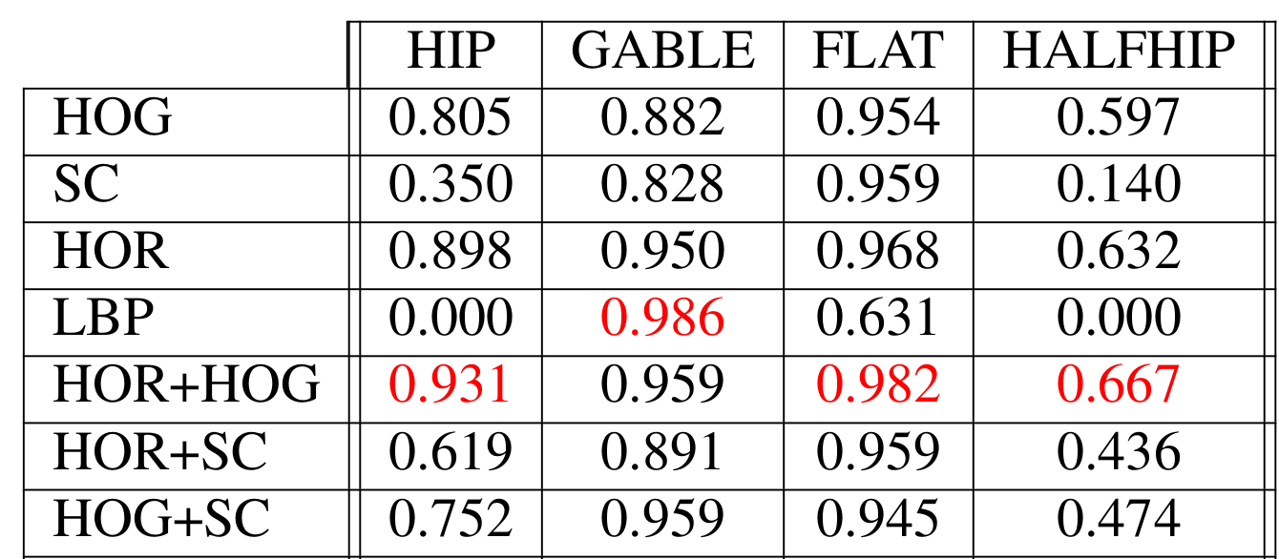
Compare with several well-known image features:
F1 score of classification results
Notes:
10/29/17
41
41
Hog: histogram of gradient
Sc: shape context
LBP: local binary pattern

Slide 42
Motivations and Importance of the problem.
Introduction and novel contributions.
Data synthesis in data space.
Learning from synthetic data.
Eliminating synthetic gap.
Data synthesis in feature space.
Conclusion.
Notes:
10/29/17
42
42

Slide 43
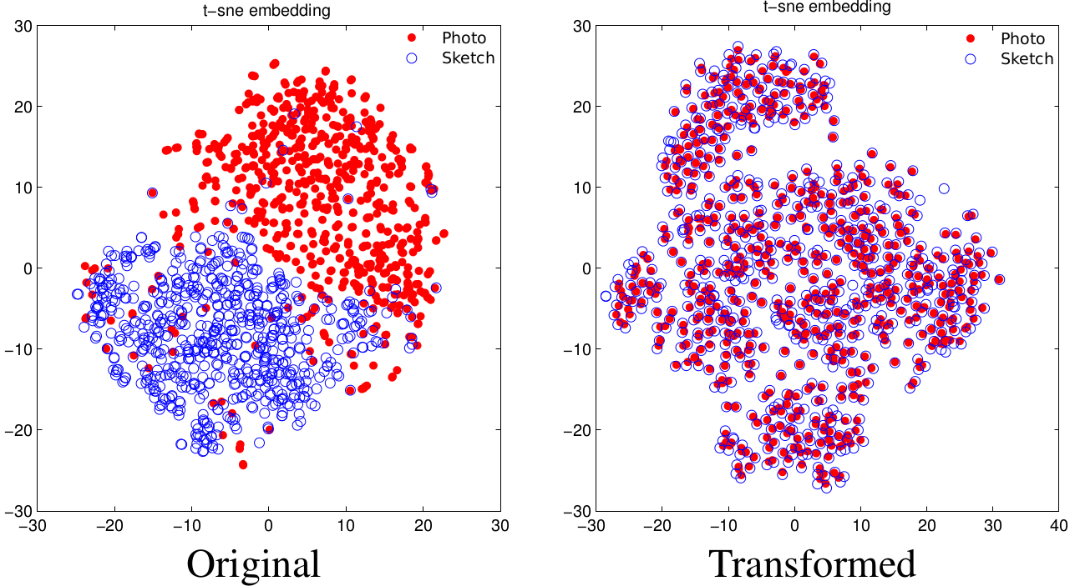
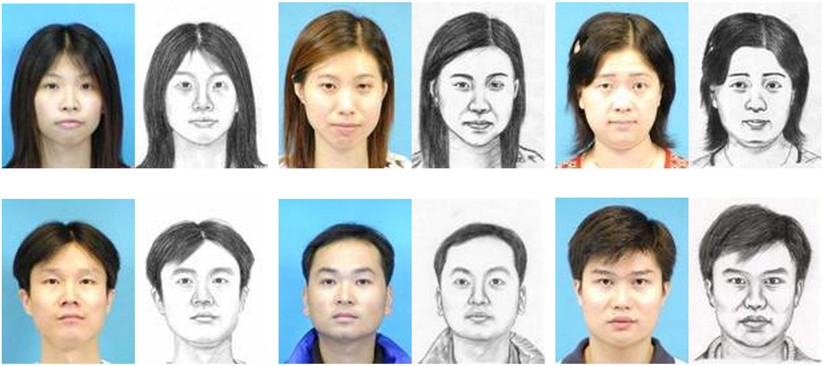
Eliminate Synthetic Gap
Notes:
10/29/17
43
43
Synthetic gap is defined as a difference between the distribution of synthetic data and actual data.

Slide 44
Previous work.
Eliminate distribution means in Kernel Reproducing Hilbert Space (KRHS). [12][46]
Subspace alignment. [35][24]
Deep neural network using KRHS as domain loss. [32][19]
Notes:
10/29/17
44
44

Slide 45
I proposed Multi-Channel Autoencoder (MCAE)
Notes:
10/29/17
45
45

Slide 46
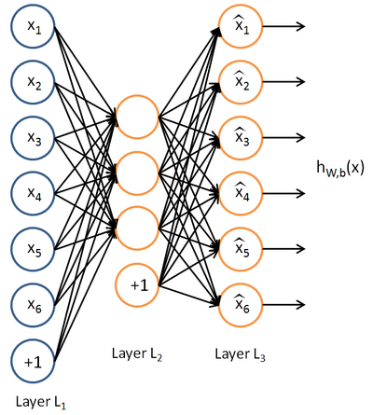
I proposed Multi-Channel Autoencoder (MCAE)
D
e
L
c
θ
d
θ
R
o
d
d
i
n
g
θ
E
e
n
c
o
d
i
n
g
task one
task two
Traditional AutoEncoder
MCAE
Notes:
10/29/17
46
46

Slide 47
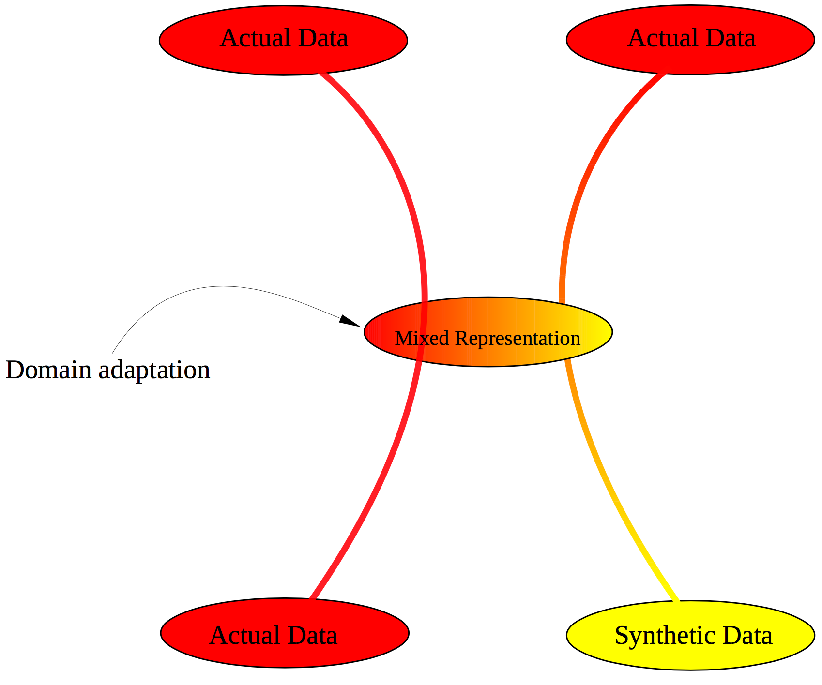
Configuration of MCAE
Notes:
10/29/17
47
47

Slide 48
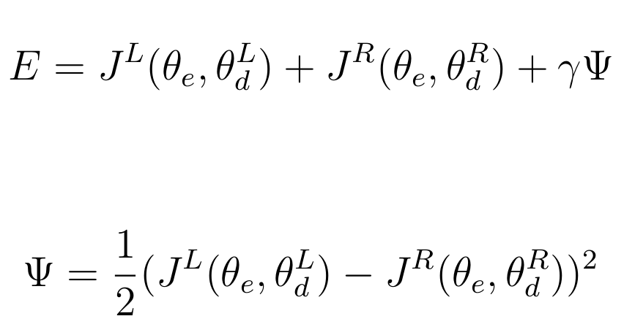
MCAE
Jointly learn two tasks, left and right, together.
where
Notes:
10/29/17
48
48
The regularization term control the learning balance between two branches.

Slide 49
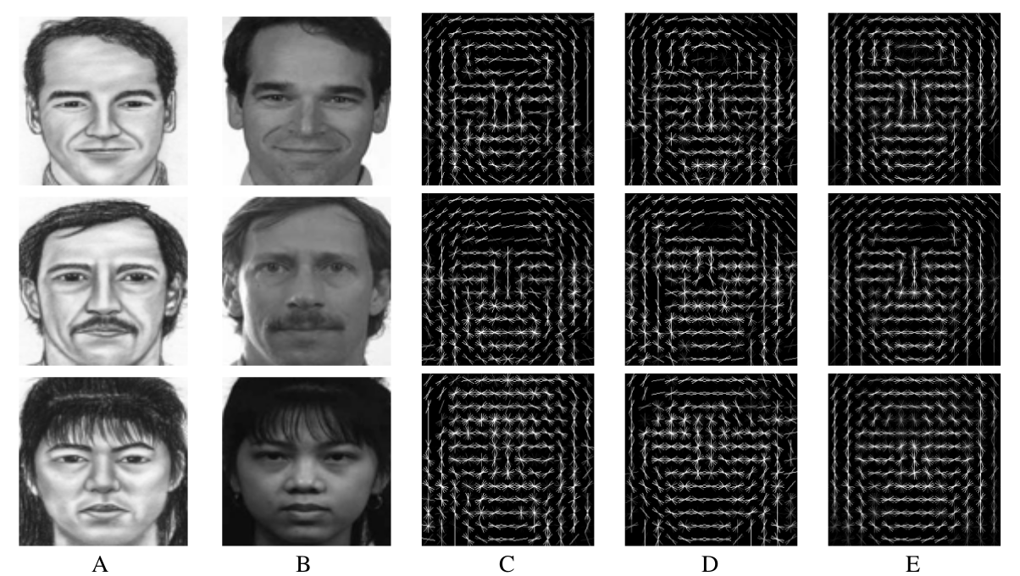
Visualization of domain adaptation. [25]
A: Sketch. B: Photo. C: Original sketch HOG. D: Photo HOG. E: Transformed sketch HOG.
Notes:
10/29/17
49
49
The goal is to make E looks like D as much as possible

Slide 50
Notes:
10/29/17
50
50

Slide 51
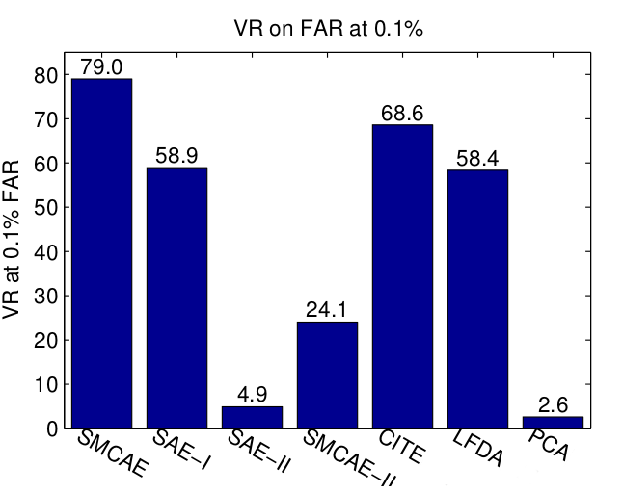
Classification results
Results are evaluated on CUFSF data from [119]
Notes:
10/29/17
51
51

Slide 52
Motivations and Importance of the problem.
Introduction and novel contributions.
Data synthesis in data space.
Learning from synthetic data.
Eliminating synthetic gap.
Data synthesis in feature space.
Conclusion.
Notes:
10/29/17
52
52

Slide 53
Uneven distribution of data in classification
With uneven data distribution in classification problem, it usually require imbalanced data has an ability to compromise the performance of classification algorithm.
It is hard to detect patterns, regularities within a minority class
The general bias used in many classification algorithm make it hard to learn from the minority class.
Noise impacts more to the minority class.
Notes:
10/29/17
53
53
In most of computer vision tasks, it requires that extract features from existing data. Especially in classification problem, if the distribution of these features are not even, it usually require imbalanced data has an ability to compromise the performance of classification algorithm.
1. it is difficult for learning algorithm to approximate the truth decision boundary.
2. Second, many classification algorithms utilize a general bias for better generalization and to avoid overfitting during learning.
3. Last but not least, noise exerts a greater impact on the minority class, because in this case it is more difficult for a classifier to distinguish noise from minority data.

Slide 54
Solving uneven data distribution through data synthesis in feature space.
Existing work:
There are primarily three groups of methods that can solve imbalanced learning problems [19].
Cost sensitive methods.
Kernel methods.
Sampling methods.
Notes:
10/29/17
54
54
1. different cost weights are formed in a cost matrix which is applied to misclassified samples during learning.
2. In some learning algorithm where kernel techniques are used, to tackle imbalanced problem. The kernel usually is designed to be more resistant to imbalanced data.
3. You can either oversample minority class or downsampling majority class.

Slide 55

SMOTE [4] and its variants [2][7][17][18] etc.
Notes:
10/29/17
55
55
1. Another famous oversampling technique is called denoted as SMOTE which is short for Synthetic Minority Oversampling Technique.
2. The basic idea about SMOTE is that, it will evenly and randomly pick samples or we call it seeds from minority class.
3. Once a seed is chosen, SMOTE will look at neighbors of the seed, and do an other random pick to choose one of neighbors.
4. Then to get a feature representation for a new synthetic sample, SMOTE will do a linear interpolation between the seed and its picked neighbor.
5. SMOTE will iterative this process until the distribution of all classes becoming even.
6. However, usually in a classification problem, we hope an added synthetic data can help improve the decision boundary. But, for example in this plot, suppose we are adding a new synthetic sample to a place which is far away from the decision boundary, then it has nothing to do to improve the decision boundary. In this case, we waste this synthetic sample.
7. To solve the problem of SMOTE, Some variants of SMOTE proposed to add synthetic data exactly in the decision region. However, we don't think this is safe thing to do, and the improvement of performance is not gauranteed.

Slide 56
The proposed approach – CGMOS [27]
What is CGMOS
CGMOS is an oversampling technique that uses the same framework proposed by SMOTE.
CGMOS can synthesize new samples that will improve the overall certainty of the entire dataset in classification.
CGMOS is theoretically proved to work better than SMOTE during training when using Bayesian classification.
Notes:
10/29/17
56
56
1. CGMOS is a certainty guided oversampling technique
3. Different from all other methods that extended from SMOTE. Further more, in our experiment, CGMOS almost achieve the best results for all tests we conducted.

Slide 57



Definition of certainty
Given Bayes rule in a binary classification problem:
For a data sample representing features and class label. The certainty for this sample in the majority and minority class are respectively defined as:
$$\left(x_{j},y_{j}\right)$$
Notes:
10/29/17
57
57
We define certainty for each sample as a posterior of the sample classified as its ground truth class.

Slide 58

Relative Certainty Change
The relative certainty change is computed as a certainty change comparing the certainty before and after a new sample is added.
Notes:
10/29/17
58
58
CGMOS selects samples based on weights assigned to sample. Larger weight will get high probability to be chosen.
Weight represents by adding a sample at x_i, how the sum of all other samples’ certainties are affected.

Slide 59




Weight computation for seed selection
CGMOS selects a seed according to a weight assigned to the seed.
$$W\left(x_{i}\right)$$
The weight is computed as a sum of relative certainty change from all samples in dataset if adding a new sample to
$$W\left(x_{i}\right)$$
$$x_{i}$$
Weight is computed as:
Notes:
10/29/17
59
59
CGMOS selects samples based on weights assigned to sample. Larger weight will get high probability to be chosen.
Weight represents by adding a sample at x_i, how the sum of all other samples’ certainties are affected.

Slide 60



Theoretical guarantee over SMOTE
Definition (Average gain): The average gain when adding sample is defined by:
$$x_{i}$$
where
Theorem: The expected average gain in CGMOS is higher or equal to that of SMOTE.
Notes:
10/29/17
60
60
Like I said, different from all other methods that extended from SMOTE, we actually theoretically proof that the expected gain in CGMOS is higher or equal to that of SMOTE.
For more details of the proof, please refer to our paper.

Slide 61

Certainty
Left: Minority class, Right: Majority class
Notes:
10/29/17
61
61
It is hard for an imbalanced data to compromize the performance of standard learning algorithms (Bayes, svm and decision tree etc.)

Slide 62

Weight computation
Left: Minority class, Right: Majority class
Notes:
10/29/17
62
62
Now, we will look at how a single new synthetic data is added to the location of any existing data in minority class will affect the change of certainty of entire class.
Color basically means how a new data can improve the certainty of entire dataset when a new sample is added to that location.

Slide 63
Results
Datasets: 30 datasets downloaded from UC Irvine machine learning repository corresponding to existing evaluations [160].
Compared approaches: No addition, Duplication, SMOTE [35], Boarderline-SMOTE [36], ADASYN [37], MWMOTE [156], and RAMOBoost [154].
Classifiers: Bayes with KDE, K nearest neighbors, Adaboost.M1, SVM, Neural networks, Random forest according to existing evaluations.
Notes:
10/29/17
63
63

Slide 64

Notes:
10/29/17
64
64
F1 scores

Slide 65
Motivations and Importance of the problem.
Introduction and novel contributions.
Data synthesis in data space.
Learning from synthetic data.
Eliminating synthetic gap.
Data synthesis in feature space.
Conclusion.
Notes:
10/29/17
65
65

Slide 66
Conclusion
Goals:
Use data synthesis techniques to
Boost performance of object recognition.
Ease ground truth labeling process.
Novel contributions:
Data synthesis in data space.
Features to learn from synthetic data
Eliminating synthetic gap.
Data synthesis in feature space.
Future works:
Deep learning based data synthesis.
Automatically synthesize more complicated data such as video, 3D object, etc..
Notes:
10/29/17
66
66
During my Ph.D. study, my researches focused on boosting performance of computer vision tasks using synthetic data. The proposed methods and techniques are applied to several computer vision application such satellite image analysis, 3d point cloud processing, human face retrieval, object tracking and so. In summary, four primary contributions are made:

Slide 67
Thank you very much
Questions and Comments?

Slide 68


Real Data
Synthesized Data
Notes:
10/29/17
68
68

Slide 69

Roof style classification results compared to unsupervised approaches.
Notes:
10/29/17
69
69

Slide 70

Results
[87]
[88]
[2]
[77]
Notes:
10/29/17
70
70
The first two methods are traditional ones which do not require training and they generate best results for all cases. However, the processing time is much much longer than dnn based method.
FlowNetS is trained supervisely. Although in most of cases, it has better results than unsupervisely trained models such as later three models. Training it require hundreds of thousands well labelled optical flow data, which is unrealistic in many cases.
One result that worth noticing is KITTI column, For KITTI it only get about 200 samples with ground truth optical flows for training. But the entire dataset has about 80K image pairs.

Slide 71

Results
Notes:
10/29/17
71
71
The first two methods are traditional ones which do not require training and they generate best results for all cases. However, the processing time is much much longer than dnn based method.
FlowNetS is trained supervisely. Although in most of cases, it has better results than unsupervisely trained models such as later three models. Training it require hundreds of thousands well labelled optical flow data, which is unrealistic in many cases.
One result that worth noticing is KITTI column, For KITTI it only get about 200 samples with ground truth optical flows for training. But the entire dataset has about 80K image pairs.

Slide 72
The proposed MCAE
D
e
L
c
θ
d
θ
R
o
d
d
i
n
g
θ
E
e
n
c
o
d
i
n
g
task one
task two
Basic structure
Stacked up
Notes:
10/29/17
72
72

Slide 73

Notes:
10/29/17
73
73
T-sne reduce dimension to 2

Slide 74

ROC curves
Notes:
10/29/17
74
74

Slide 75

Existing sampling methods
Creating identical samples.
Notes:
10/29/17
75
75
1. Blue stars represent minority class, circles are samples of majority class.
2. Let us suppose that the red dashed box around minority class is a ground truth decision boundary of the minority class.
3. Now, if we add more and more identical copies of existing data for minority class. The classification algorithm to focus on learning each single cluster of data in the minority class, which in turn will force the decision boundary to shrink, And at the end, the learning algorithm will overfitting.

Slide 76

Statistical significance analysis
Given the significance level as 5%, we compute the p-values of statistical significance tests of classification results using CGMOS against the compared methods:
CGMOS is statistical significantly better then the compared methods regardless of classifiers selected.
Notes:
10/29/17
76
76

Slide 77

Text to image synthesis [22]

Slide 78

Text to image synthesis [22]

Slide 79


This flower has one large purple and white petal with one yellow and orange receptacle.
This flower has flat long and skinny yellow petals in one slightly upturned ring configuration.

Slide 80

































Flat
Flat Edge
Ridge
Ridge Corner
Valley
Valley Corner
Flat
Flat
Gable
Gable
Gable
Gable
Slop Ridge Corner
Slop Ridge
L-Joint
Slop Valley
Slop Valley
Reverse L Joint
L-Joint
L-Joint
L-Joint
L-Joint
Corner
L-Joint
L-Joint
T-Joint
Reverse T Joint
X-Joint
Reverse X Joint
Slop Edge I
Slop Edge II
T-Joint
T-Joint
X-Joint
X-Joint
Slop
Slop
Slop
Gambrel Corner I
Gambrel Ridge I
Gambrel Corner II
Gambrel Ridge II
Mansard Ridge I
Slop
Gambrel
Gambrel
Gambrel
Gambrel
Mansard
Mansard Corner I
Mansard Corner II
Mansard Ridge II
Loft Joint
Pyramid Joint I
Pyramid Joint II
Mansard
Mansard
Mansard
Loft
Pyramid
Pyramid
Hex Joint
Reverse Hip Joint
Hip Joint
Hex
Hip
Hip
Notes:
10/29/17
80
80
33 types of key points are defined.

Slide 81


Boost recognition rate by adding synthetic data.
Chicago
San Francisco
Notes:
10/29/17
81
81
To show advantage of using models derived by these carefully designed models as training data. I compared results to unsupervised clustering algorithm, GMM and Kmeans.
For roofs that are rare in real world, my approach over perform compared method a lot. That’s because more features can be generated and trained using the proposed method.

